Slide 1


Notes:
We are excited to announce the upcoming 2023 Colorado Gives Day Corporate Challenge sponsored by Delta Dental of Colorado, and we invite you to join this impactful event. It is easy and fun to participate, you just create a fundraising page and share it with employees to raise funds for your favorite causes.

Slide 2

Notes:
Colorado Gives Day is Tuesday, Dec. 5.
Last year, Coloradans came together to raise more than $53 million.
Colorado’s companies participated in the Corporate Challenge, presented by Delta Dental of Colorado.

Slide 3

Giving Made Easy
Raise $1000 get $1000
  Choose [YOUR NONPROFIT] to support.
  Create a custom branded giving page in minutes.
  Share. Raise $1000.
  Delta Dental will match with $1000.
Notes:
Delta Dental of Colorado sponsored the 2022 Corporate Challenge, provided an exciting opportunity for companies to participate in Colorado Gives Day, the state’s largest giving day. Companies of all sizes created a group fundraising page, allowed employees to donate to organizations that align with their personal and corporate values. The page could be customized to promote causes that the company is connected to. As a bonus, Delta Dental of Colorado Foundation provided the first 100 companies who created a page and raised $1,000 with a $1,000 match, totaling $100,000 in matching gifts. From November 1 to Colorado Gives Day, all participating companies had access to a fundraising page, communications plan, toolkit, and more to inspire employee giving.

Slide 4
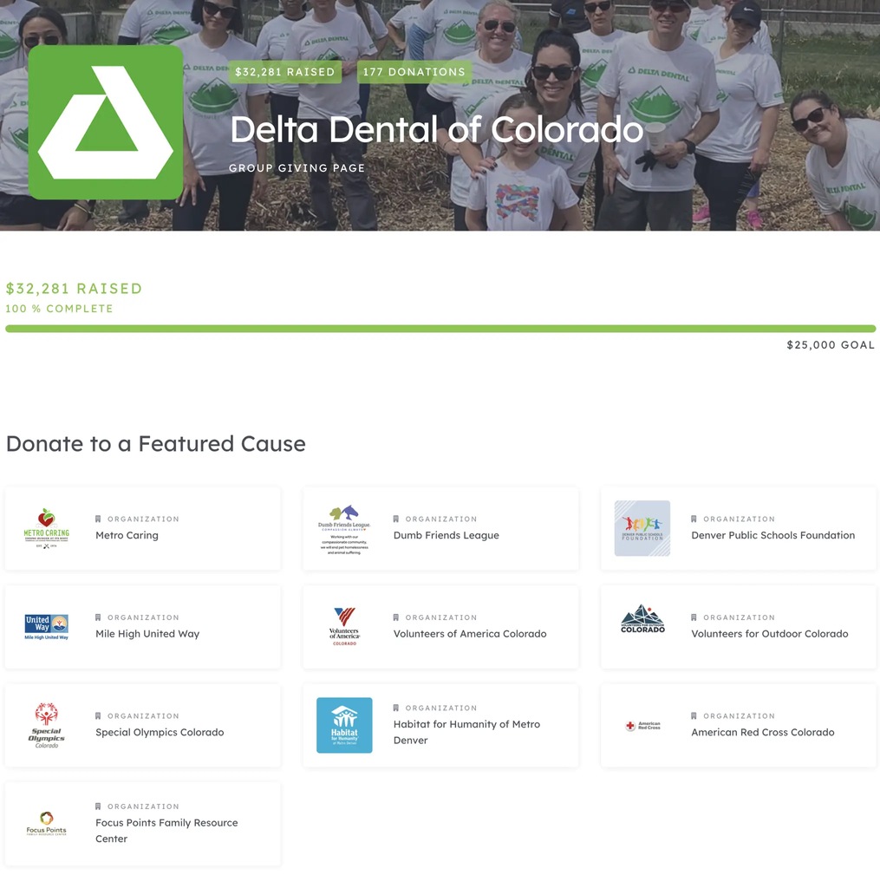
Get Started
Create a Page: Short instructional video Watch Now
Set up a Match: Incentive donations with a match Watch Now
Contact Us: We are here to support
Email Us

Slide 5
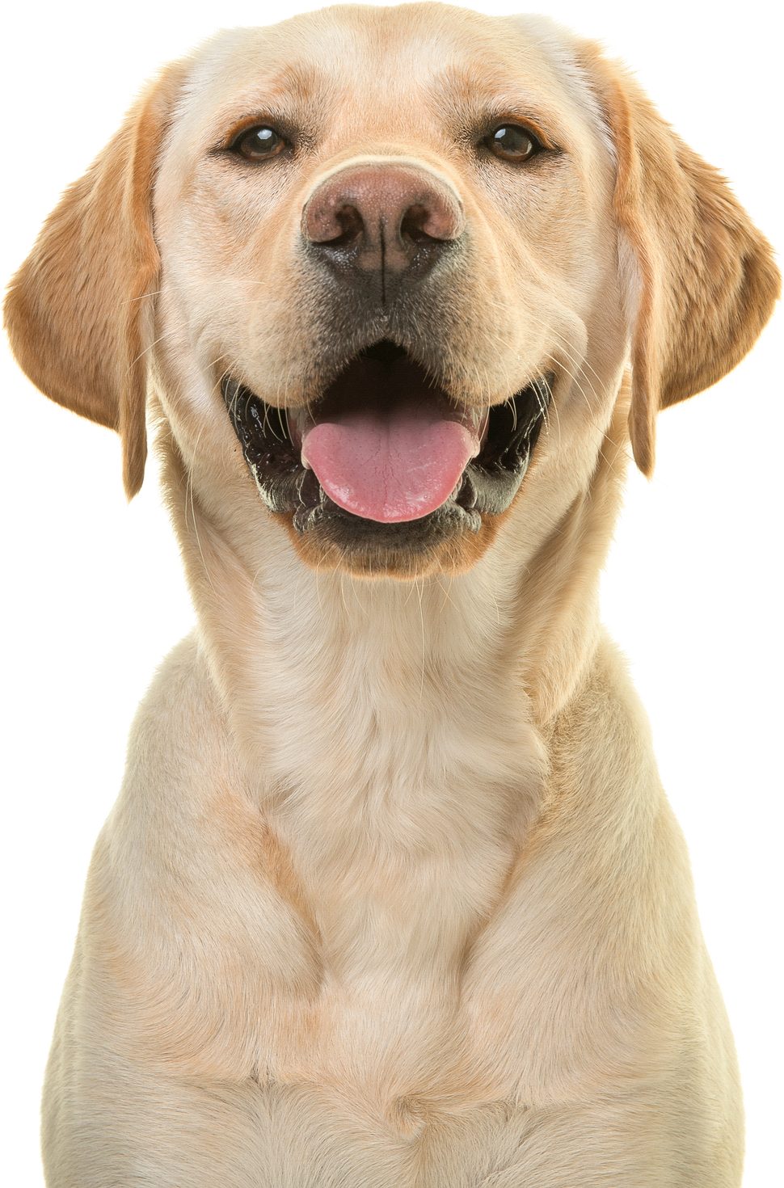
About [YOUR NONPROFIT]!
Add a short mention about your mission and how their support will help you achieve it.
Then, add a photo to the right that shows impact.

Slide 6
Colorado Gives Day.
Easily the best day to give.
Tips:
  Share a photo of the nonprofit(s) you’re supporting. Pull it from their ColoradoGives.org organization page.
  Make a QR code to make giving quick and easy.
  Colorado Gives Foundation can make you a QR code if you need help.
  Contact: Hello@ColoradoGivesFoundation.org.

