Slide 1



Good for Business Challenge
Sponsored by Delta Dental of Colorado

Slide 2


Colorado Gives Day
December 10, 2024
  Created by Colorado Gives Foundation
  Support local nonprofits
  Statewide giving movement
  $54 million+ was raised in 2023

Slide 3


Good for Business Challenge
sponsored by
of Colorado
Create a culture of generosity
Improve your brand reputation

Slide 4
About [Your Nonprofit]
  [Brief mention of your mission and vision.]
  [How can this business support your work through participating?]
  [Add a photo of your nonprofit in action]

Slide 5


It’s easy to participate.
Choose your favorite Colorado nonprofit(s) to support.
Create a custom-branded group giving page in minutes.
Share, raise and compete with other Colorado businesses.
First 50 businesses to raise $1,000 will get an additional $1,000 to share with their designated nonprofit.

Slide 6
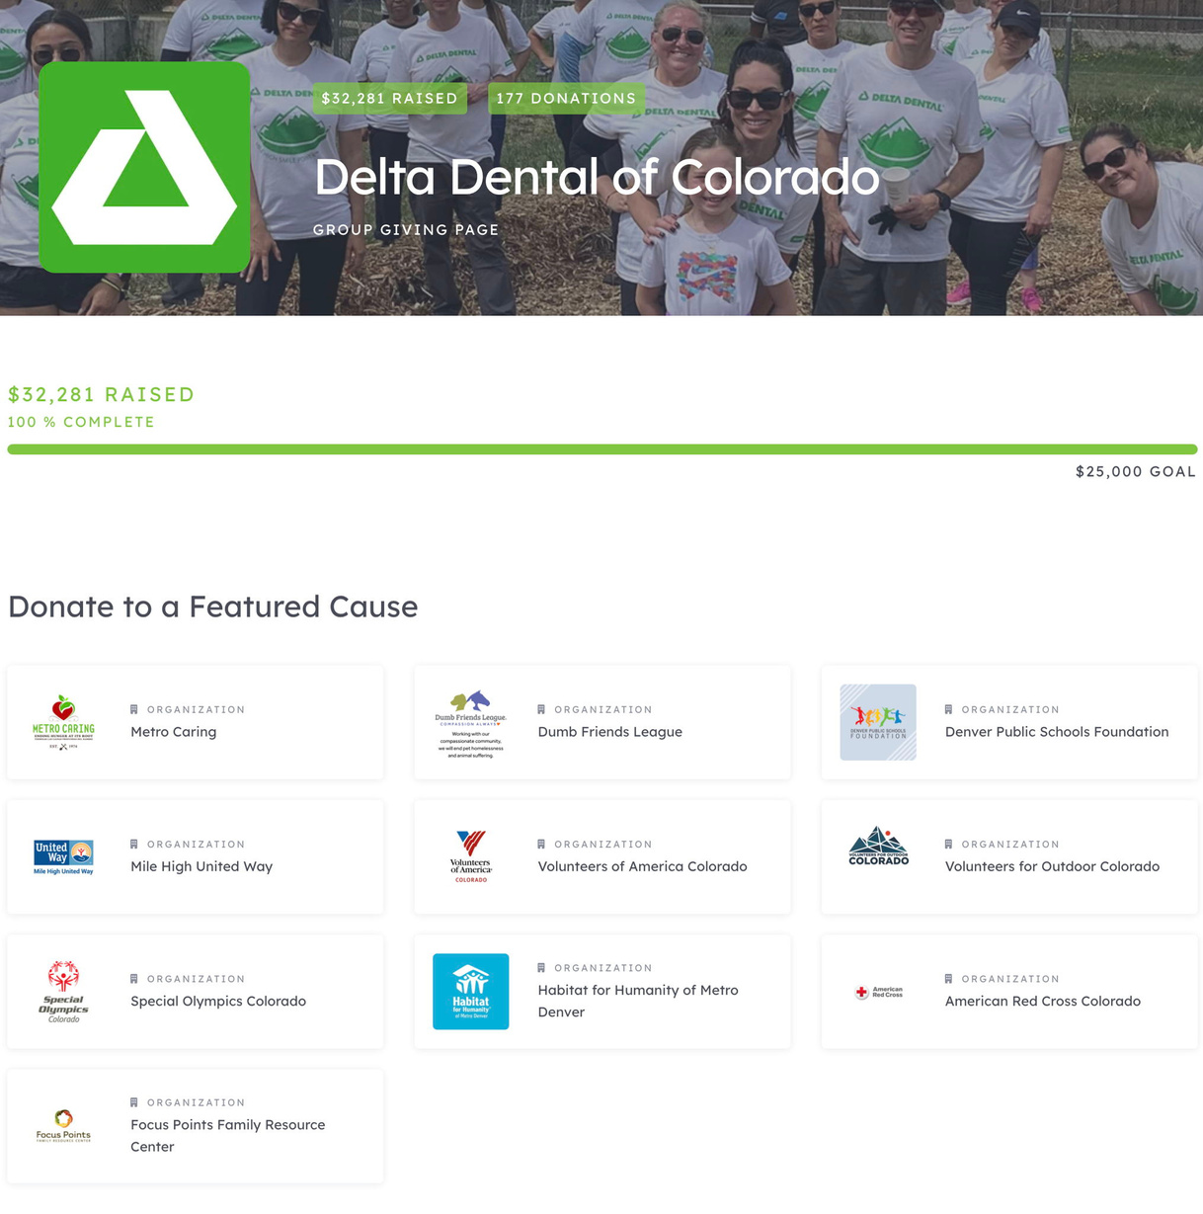
Example of a custom-branded group giving page on ColoradoGives.org

Slide 7


Ready to join the challenge?
Here are a few video tutorials to help you get started:

